Slide 1

Using this Slide Deck
This slide deck is like a workbook. Add in and take out what’s needed.
Use the template slides that work for your event. Right-click>Duplicate Slide as needed. Delete the others.
Update an image – Right- click > Change Picture.
The notes panel for the required slides contains suggested script. Update this script as needed.
Add your thoughts about the session topic into the Notes Panel. Print notes prior - File>Export>Create Handouts>Notes below slides OR use multiple monitors so the notes panel can be visible.
Contact your SciSoc program manager for support as needed.

Slide 2
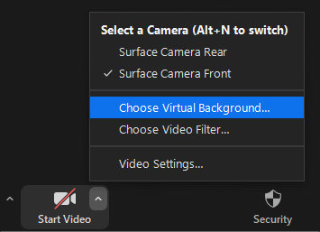


Prepare Event Systems
Check audio input/output
Mic’d setup works best for quality volume and clarity
Set your background
Actual or virtual background
Confirm proper lighting
Natural or artificial lighting from the front of your view
Contact your SciSoc program manager for support as needed.

Slide 3
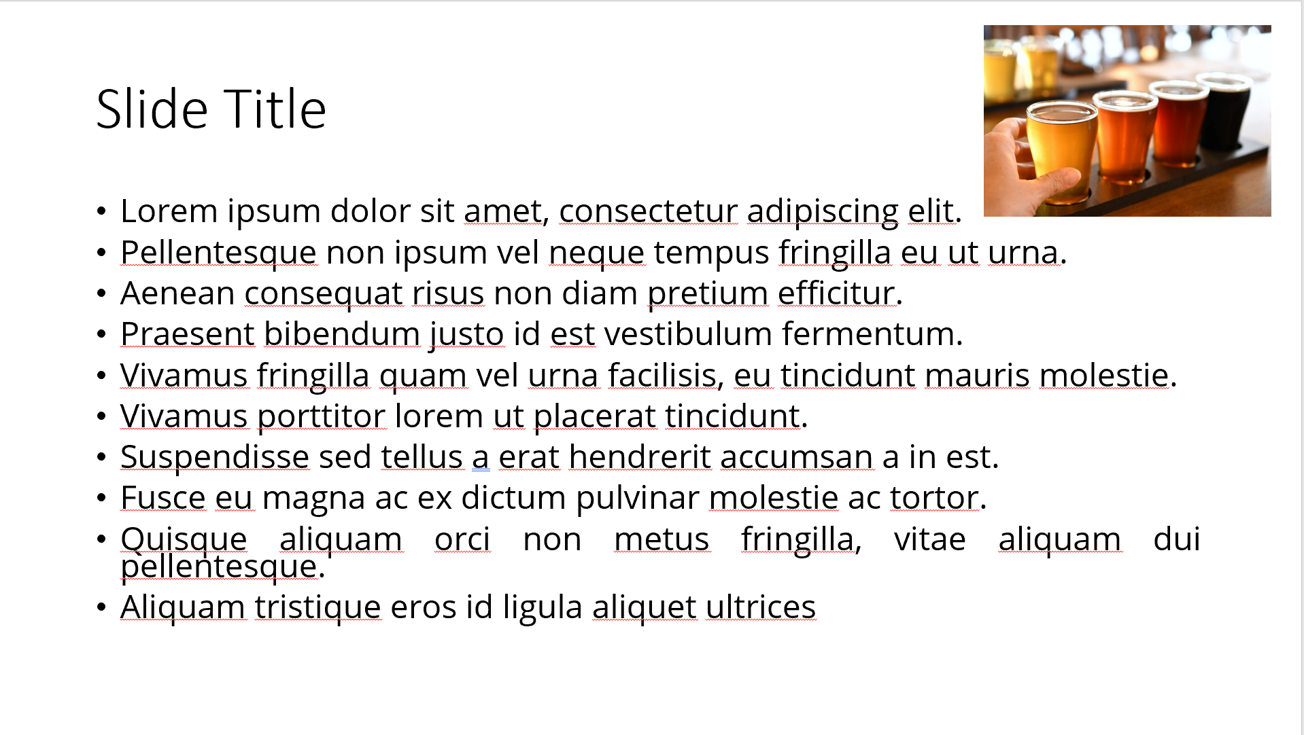
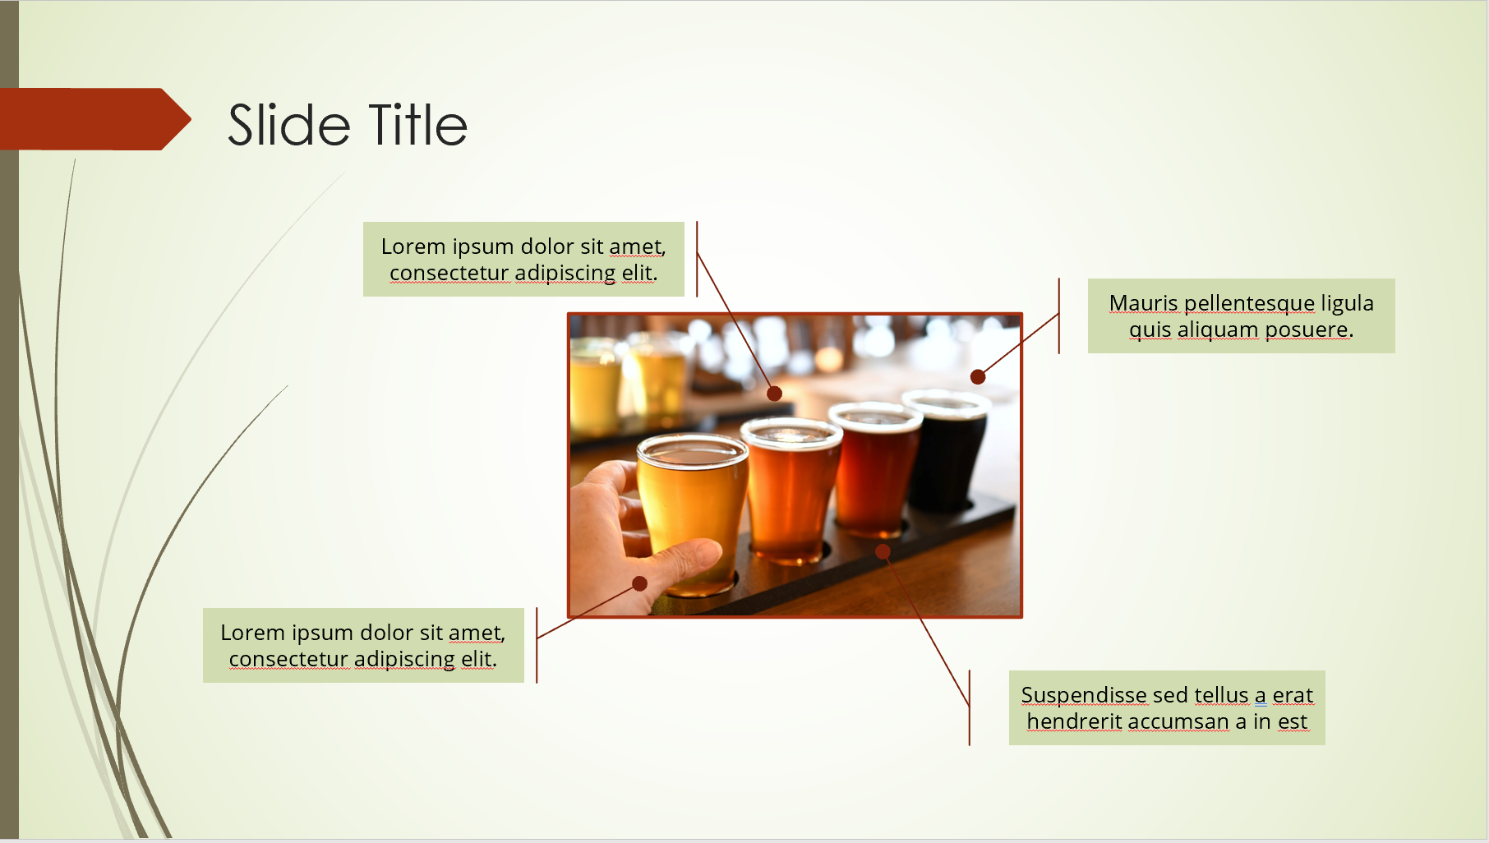
Ensure Slide Clarity
Contact your SciSoc program manager for support as needed.
Notes:
The clarity of your slide and what you put on it should enhance your message.
Ensure the following:
Ample white space. Don’t crowd the slide.
Ideally 1-2 ideas discussed per slide.
Avoid dense bullet point slides and a content dump. Put those details in your notes instead.
Aim for foreground/background color contrast.
Use purposeful images or illustrations that you can talk to from your presenter notes.

Slide 4
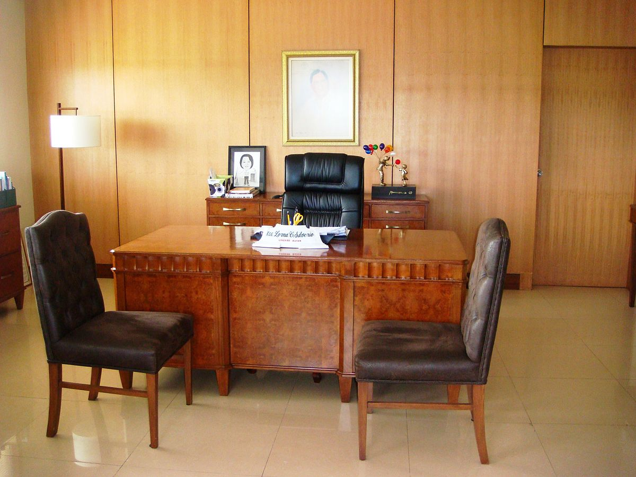
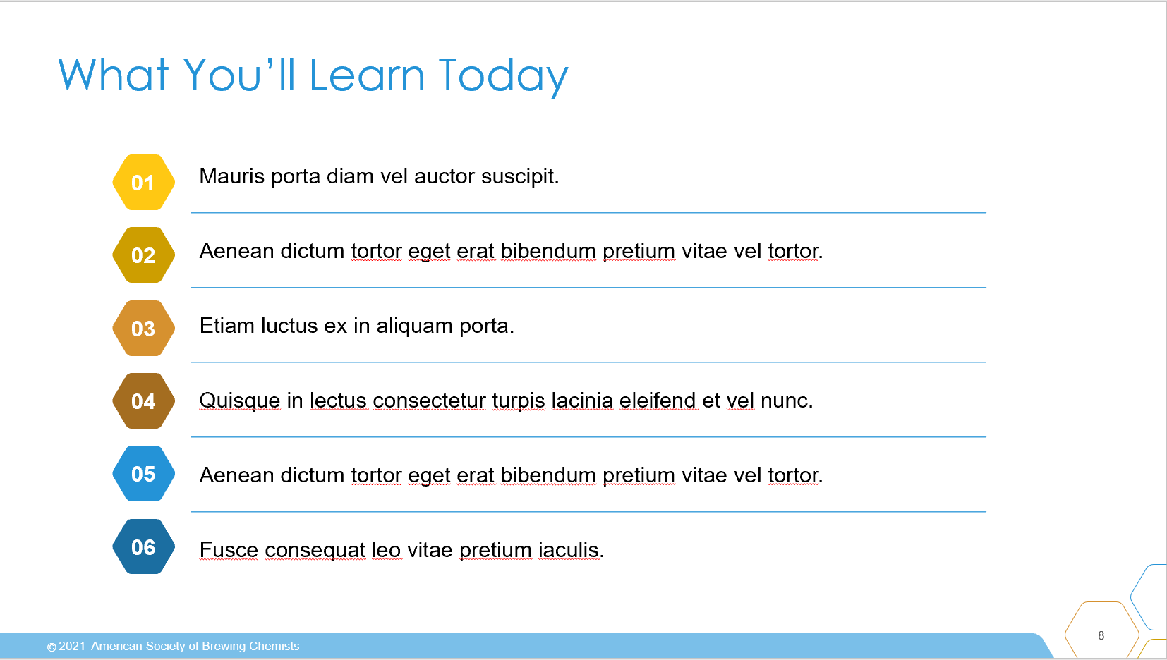
Engage the Attendees
Take a look at the topics we’ll cover today. Type into Chat which one interests you the most.
Let’s kick off today's session with a poll! Tell me which of todays topics most interests you?
If we get a strong result in one direction it can help guide the timing of our topics.
OR
POLL
topic 1
topic 2
topic 3
Contact your SciSoc program manager for support as needed.
Notes:
An engaged attendee is one that does minimal multi-tasking during your session. They should be energized and enlightened by the experience, confident applying what they’ve learned or a better understanding of the topic and be an association advocate with nonmembers to help grown our member knowledge to continue sharing and networking.
Session goals:
Connect the session outcomes to their work world. What are challenges spurred them to register? At session end, what content nugget can they apply immediately back at work?
Interact with attendees every 3-5 minutes (less often for webinar, more for courses). Polls, commenting in chat, breakout rooms, etc.
Advance the slide every 1 minute with 1-2 topics per slide.
Capture attention with compelling graphics, video, and charts. Avoid dense bullet point slides.
Address attendees by name when possible.
Enable attendee video to create a classroom or live event feel. Ask attendees to ensure their name that appears is accurately on their video (Right click image > Rename)
Allow “conversations” (including private) to give attendees a chance to interact with you and their peers about content.
Encourage attendees to share ideas and information using various virtual modalities. Ideally respond to Questions as they come in and not wait until the end of the presentation. This would require the moderator to review the Q&A panel for timely questions.
Share additional resources to extend the learning outside the session (websites, social media, linked documents, etc.).

Slide 5

Get Copyright Permission
Contact your SciSoc program manager for support as needed.
This Photo by Unknown Author is licensed under CC BY-NC
Notes:
As a reminder, you must own or have permission to use all media (images, illustration, video) or documentation used in this presentation.
This is an issue that can have financial repercussion to your association and one we are careful to adhere to.

Slide 6

Presentation Title Here
Click on photo to replace

Slide 7
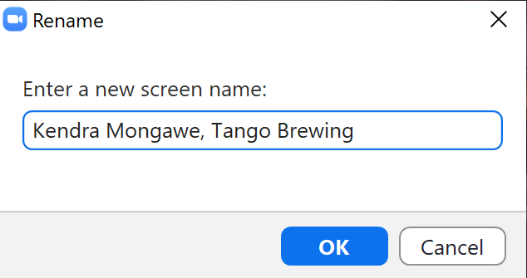
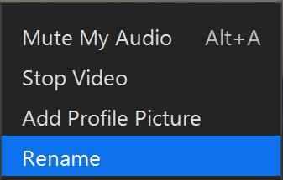
Introduce Yourself Virtually
Notes:
DO:
A good way to ensure a solid start with this idea is to confirm your screen name is as you would like it to appear. We suggest your full name and where you work, or you could put your role instead of workplace.
To do this simply right-click your video and select Rename.

Slide 8
What You’ll Learn Today
Resize width of table to fit text
Text can be made slightly larger or smaller to accommodate content
Add or delete numbers and table rows to match item list
Vertically re-center table (& numbers) if adding or deleting rows
Add line item here
Add line item here
01
02
03
04
05
06
Notes:
SAY:
By the end of my presentation you will/be able to:
{insert topic or objective]
DO:
Keep these succinct. Actionable ideally. Try to use a similar beginning to each line to ease reading. For example, avoid starting one line with a question “how to …” and another with a verb. You can add a line prior so its easier to start the list, such as “By the end of the session, attendees will be able to:”

Slide 9
Title and Content Layout
First level bullet
  increase list level for sub-bullets

Slide 10
Two Content Layout
First list level is unbulleted (bold if needed)
  Bulleted text
    Bullet two
      Bullet three
        Bullet four
First list level is unbulleted (bold if needed)
  Bulleted text
    Bullet two
      Bullet three
        Bullet four

Slide 11

Title, Content, Photo Layout
Right-click the photo to replace it.

Slide 12
Chart or Graph
Use simple gray box for callouts

Slide 13
Icons
Icons can be recolored using shape fill. Icons can be used with yellow hex shape (center vertically & horizontally with shape then group). To resize icon and/or shape, use the shift key to keep the original proportions.

Slide 14
Video Title
Notes:
SAY:
DO:
Ensure some testing prior with another person to ensure audio plays for you as well as others in the meeting. Also adjust sizing to fit monitor or similar.

Slide 15
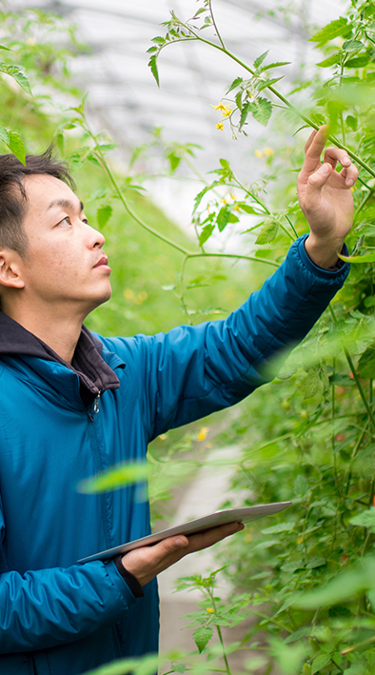
Section Header Layout
Photo can be replaced by clicking on image, deleting and clicking on icon to insert new photo

Slide 16

Poll Question
Add poll question
Delete this
shape if no callout is needed

Slide 17

Activity Instructions
  Add instructions
Delete this
shape if no callout is needed

Slide 18
Notes:
SAY:
It’s time to answer some of the questions you’ve been asking from the Q&A panel.
DO:
Make sure to use their name and show appreciation for the comment.

Slide 19

One Thing
that you’ll apply
Notes:
SAY:
Alright, so you’ve heard many great ideas, methods, strategies and similar during this presentation, but which ONE thing you heard today stands out?
What will you either apply back at work right away or that you want to look at further when you leave the session?
Take a moment to consider your ideas or look at your notes and etc. then type it into the chat panel. If you see someone’s idea that you find interesting - feel free to comment back to them. To do this typically you put an @ and then their name and type your thoughts.
I’ll be quiet and give you a few moments to share your thoughts NOW in the Chat panel.
DO:
Watch the chat panel and comment on some of the ideas coming in. Use their name and reiterate the point. “Yes, Jim Smith that was a pretty interesting stat [name] shared on the [fact]” and so on. Use this as an opportunity to ask further questions directly from attendees.

Slide 20

Resources
  Add list of events/publications/etc.
Delete this
shape if no callout is needed

