Slide 1

Using this Slide Deck
This slide deck is like a workbook. Add in and take out what’s needed.
Use the template slides that work for your presentation. Right-click>Duplicate Slide as needed. Delete the others.
Update an image – Right- click > Change Picture.
The notes panel for some slides contains suggested script. Update this script as needed.
Add your thoughts about the session topic into the Notes Panel. Print notes prior - File>Export>Create Handouts>Notes below slides OR use multiple monitors so the notes panel can be visible.
Contact your SciSoc program manager for support as needed.

Slide 2
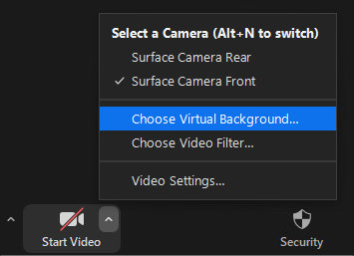


Prepare Event Systems
Check audio input/output
Mic’d setup works best for quality volume and clarity
Set your background
Actual or virtual background
Confirm proper lighting
Natural or artificial lighting from the front of your view
Contact your SciSoc program manager for support as needed.

Slide 3
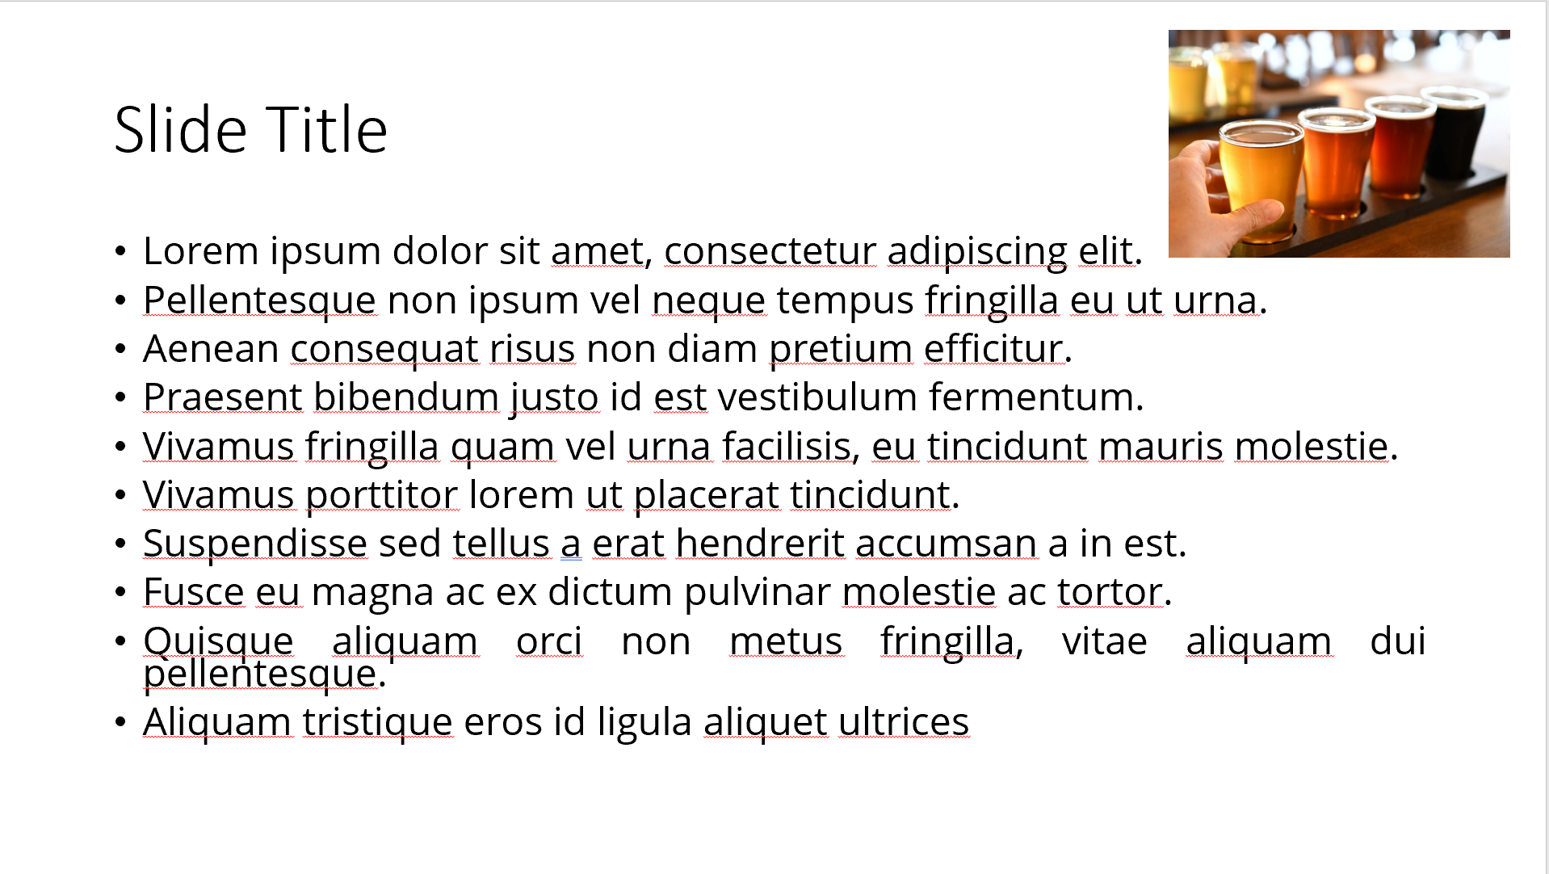
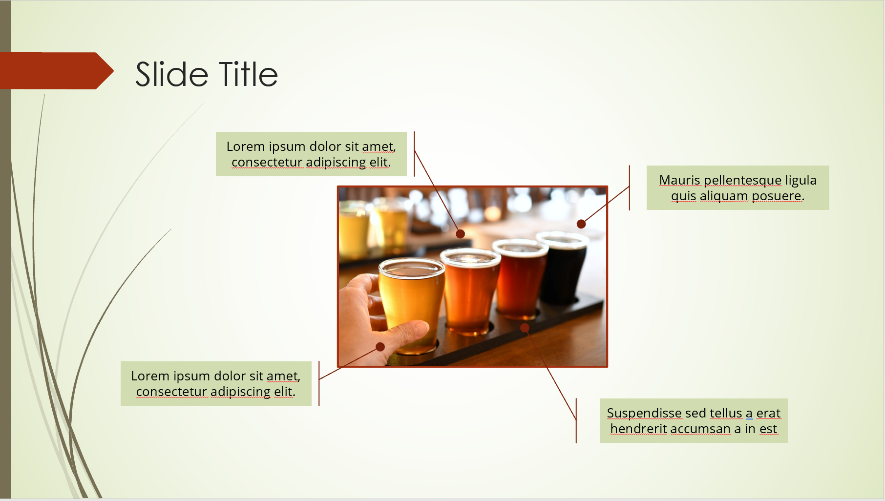
Ensure Slide Clarity
Contact your SciSoc program manager for support as needed.
Notes:
The clarity of your slide and what you put on it should enhance your message.
Ensure the following:
Ample white space. Don’t crowd the slide.
Ideally 1-2 ideas discussed per slide.
Avoid dense bullet point slides and a content dump. Put those details in your notes instead.
Aim for foreground/background color contrast.
Use purposeful images or illustrations that you can talk to from your presenter notes.

Slide 4

Get Copyright Permission
Contact your SciSoc program manager for support as needed.
This Photo by Unknown Author is licensed under CC BY-NC
Notes:
As a reminder, you must own or have permission to use all media (images, illustration, video) or documentation used in this presentation.
This is an issue that can have financial repercussion to your association and one we are careful to adhere to.

Slide 5

Presentation Title Here
Click on photo to replace

Slide 6
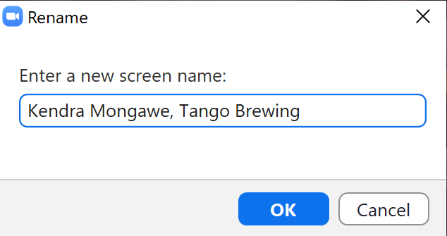
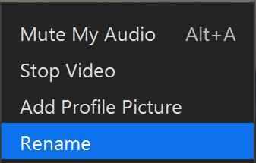
Introduce Yourself Virtually
Notes:
DO:
A good way to ensure a solid start with this idea is to confirm your screen name is as you would like it to appear. We suggest your full name and where you work, or you could put your role instead of workplace.
To do this simply right-click your video and select Rename.

Slide 7
Title and Content Layout
First level bullet
  increase list level for sub-bullets

Slide 8
Two Content Layout
First list level is unbulleted (bold if needed)
  Bulleted text
    Bullet two
      Bullet three
        Bullet four
First list level is unbulleted (bold if needed)
  Bulleted text
    Bullet two
      Bullet three
        Bullet four

Slide 9

Title, Content, Photo Layout
Right-click the photo to replace it.

Slide 10
Chart or Graph
Use simple gray box for callouts

Slide 11
Icons
Icons can be recolored using shape fill. Icons can be used with yellow hex shape (center vertically & horizontally with shape then group). To resize icon and/or shape, use the shift key to keep the original proportions.

Slide 12
Video Title
Notes:
SAY:
DO:
Ensure some testing prior with another person to ensure audio plays for you as well as others in the meeting. Also adjust sizing to fit monitor or similar.

Slide 13

Section Header Layout
Photo can be replaced by clicking on image, deleting and clicking on icon to insert new photo

Slide 14

One Thing
that you’ll apply
Notes:
SAY:
Alright, so you’ve heard many great ideas, methods, strategies and similar this session, but which ONE thing you heard today stands out?
What will you either apply back at work right away or that you want to look at further when you leave the session?
Take a moment to consider your ideas or look at your notes and etc. then type it into the chat panel. If you see someone’s idea that you find interesting - feel free to comment back to them. To do this typically you put an @ and then their name and type your thoughts.
I’ll be quiet and give you a few moments to share your thoughts NOW in the Chat panel.
DO:
Watch the chat panel and comment on some of the ideas coming in. Use their name and reiterate the point. “Yes, Jim Smith that was a pretty interesting stat [name] shared on the [fact]” and so on. Use this as an opportunity to ask further questions directly from attendees.

Slide 15

Resources
  Add list of events/publications/etc.
Delete this
shape if no callout is needed

Slide 16
Notes:
SAY:
It’s time to answer some of the questions you’ve been asking from the Q&A panel.
DO:
Make sure to use their name and show appreciation for the comment.

